Slide 1
Design presentation
A visual simulator for high-quality planning domain model
Group #2

Slide 2

Our client

Slide 3

Participation in project SCOTT

Slide 4
Our tool to develop: A visual simulator for high-quality planning domain models
Our tool is suppose to visualize and synthesize PDDL domain/problem files
By parsing the code our tool should be able to come up with an executable plan for the AI planner
The PDDL code will be visualized using states

Slide 5
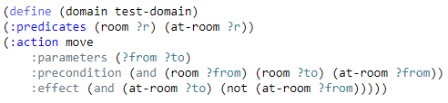
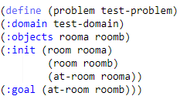
Brief recap of PDDL (Planning Domain Definition Language)
AI planning – A branch of Artificial intelligence
Realization of strategies or action sequences
Used by AI planners
Executed by AI agents (Autonomous vehicles, Robots)
PDDL consists of two files
Problem file + Domain file

Slide 6


Software architecture
C#
Val-tool for parsing PDDL code
.NET Framework

Slide 7
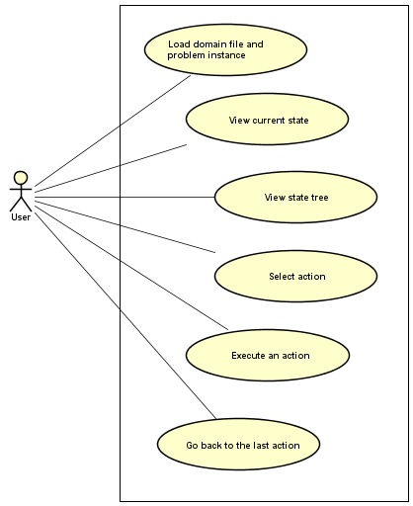
Use case diagram
Basic functionality

Slide 8
Detailed design description
Component Interface Description
Implemented using WinForms
Component Design
Event-driven by user actions
Backend consists of 6 classes

Slide 9
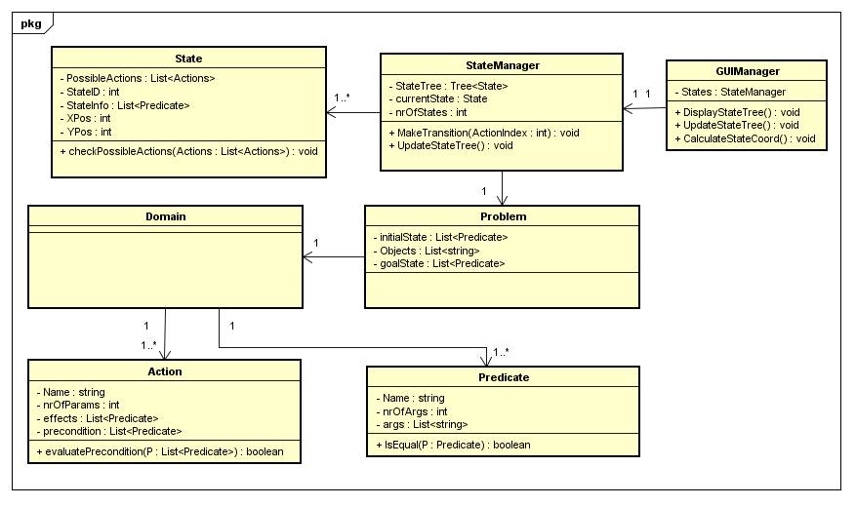
Class diagram

Slide 10
Structure of GUI

Slide 11
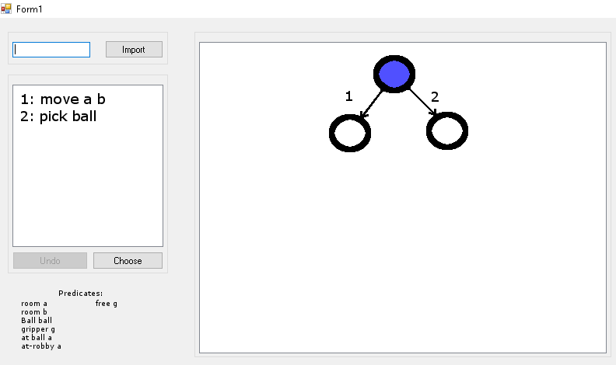

Slide 12
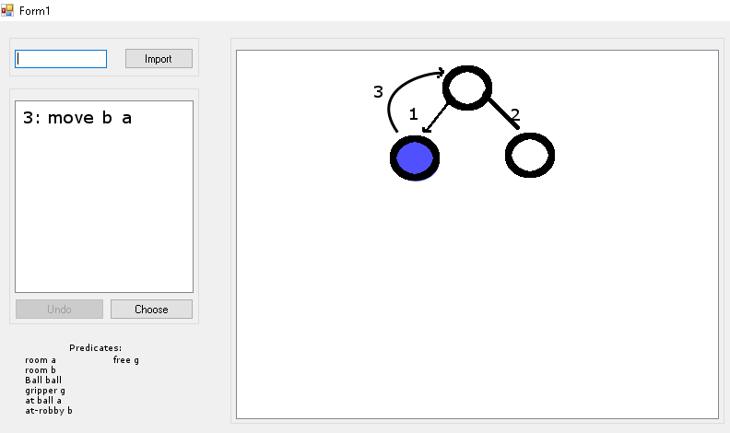

Slide 13
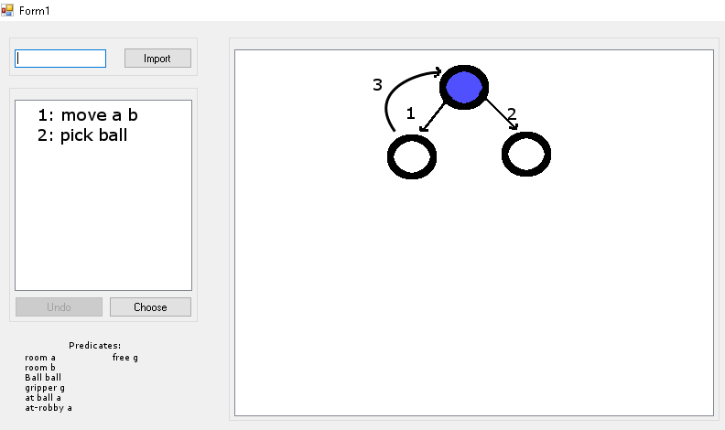

Slide 14
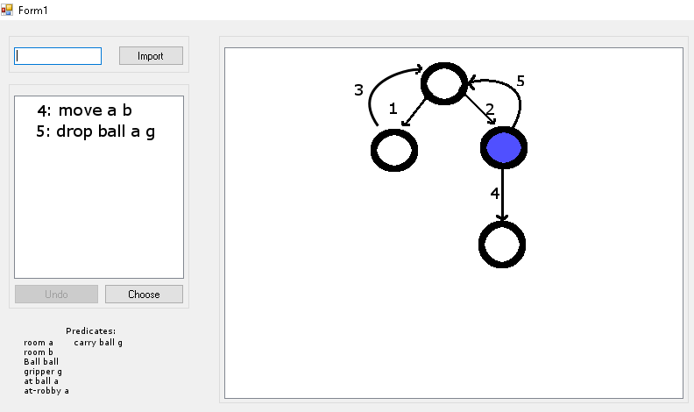

Slide 15
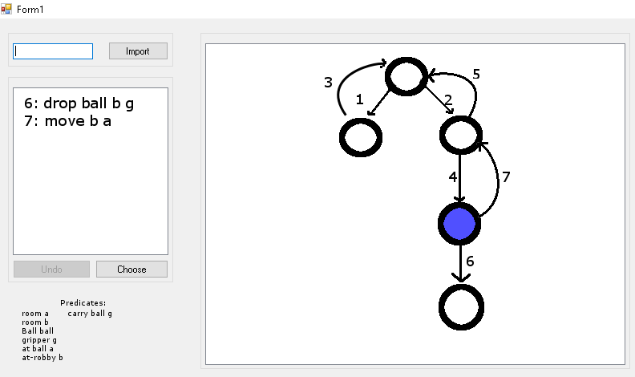

Slide 16
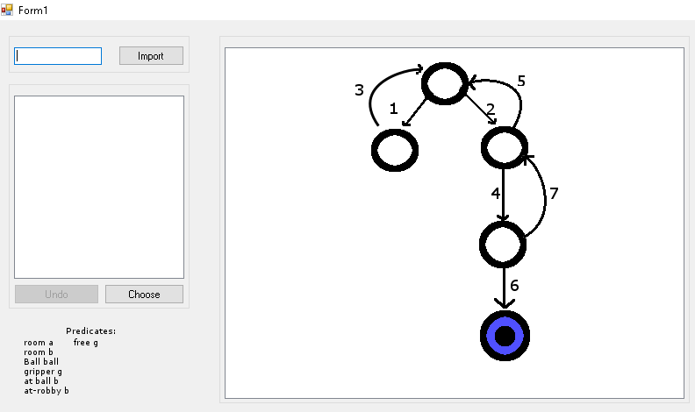

Slide 17
Implementation so far
Classes corresponding to PDDL code
Hardcoded a PDDL example

Slide 18
To be implemented
Main goals:
Importing PDDL files
Parsing domain and problem definition
Visualizing the domain model
Simulating the domain model
Returning to the previous state
Simulating the model automatically
Visualizing the state tree
Storing the state history
Secondary goals:
Checking syntax (debugging)
PDDL text editor

Slide 19
Tack!

